Slide 1
Introduction to COACH
Dirk Riehle, Univ. Erlangen
COACH A01
Licensed under CC BY 4.0 International

Slide 2
Course Goals
Learning objectives
Learn to coach agile methods teams
Understand the role of the Scrum Master
Understand agile coaching
Understand coaching people and teams
Project objectives
Help one AMOS project perform well

Slide 3
Skills Required for Course
Prerequisites
Successful completion of a past AMOS Project
Required skills
Willingness to apply social competence in project setting
Good in verbal and written communication
Ability to be observant and hands-off

Slide 4
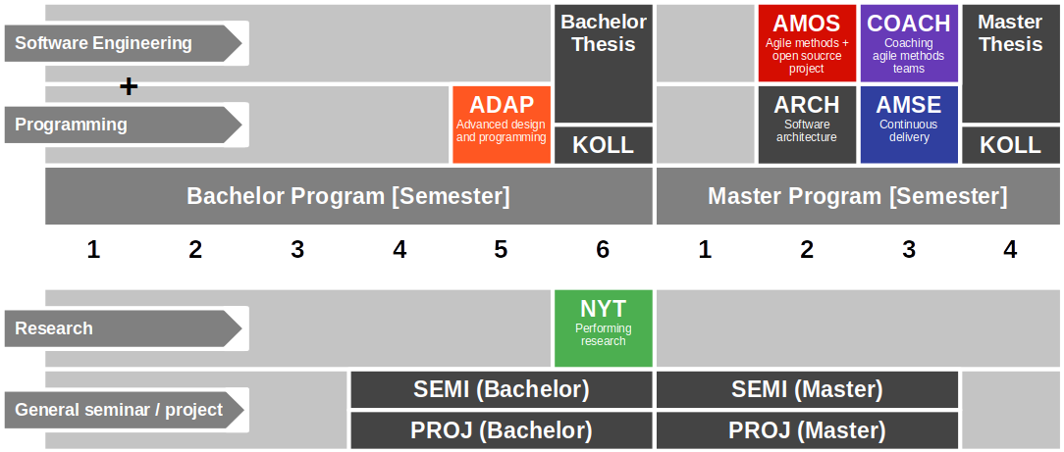
Course Position in Curriculum

Slide 5
Courses and Modules
 |  | Courses (Lehrveranstaltungen)
 |  | Lecture (2 SWS) | Exercise (2 SWS) | Total ECTS
Modules | COACH | x | x | 5

Slide 6
The Two Tasks of a COACH Student
As the Scrum Master
Coach team using agile capabilities timeline (explanation)
As a workshop facilitator
Prepare and hold workshop for your AMOS team

Slide 7
Course Grading
Scrum Master = 50% of grade
Individual contribution to teamwork = 50%
As measured in team meetings
Grading scale is [0|1|2|3]
Independent work = 50%
As measured by artifacts provided
Grading scale is [0|1|2|3]
Workshop facilitator = 50% of grade
Workshop concept (30%)
Workshop feedback (40%)
Workshop report (30%)

Slide 8
Receiving a Grade for the Course
If you want to receive a grade
You must register through your university’s exam registration system
Your degree program may have split the course into two (VL + UE)
The exam registration system is different from the course management system
Please check asap that the course is available in your degree program!
If you cannot register through the exam registration system
Please follow the instructions at https://wp.me/PDU66-2bx
Otherwise: No grade

Slide 9

No Oral or Written Exam [1]
[1] You still have to register for the course

Slide 10
Course Language
Class
Lecturer: English
Student: Choice of German or English
Project
AMOS team: German or English
Homework: Choice of German or English

Slide 11
Course Organization
Course organization
See https://coach.uni1.de
Course schedule
See Schedule tab on Course organization doc

Slide 12
This Semester’s Projects
AMOS course organization
See https://amos.uni1.de
Coach to team allocation
See Project Teams tab on AMOS Course Organization doc

Slide 13
Work Rhythm
Lecture (class discussion)
Retrospective
Exercise (team meetings)
AMOS team meeting
Homework (self-organized)
See Course Organization doc

Slide 14
Course Communication
Announcements are sent by email
Through email aliases
Through course management system
Administrative questions to teaching team
Please ask your question in the COACH backchannel
For private questions, use the teaching team email alias
Please join the COACH backchannel on Slack
We will invite you to join

Slide 15
Thank you! Any questions?
dirk.riehle@fau.de – https://oss.cs.fau.de
dirk@riehle.org – https://dirkriehle.com – @dirkriehle

Slide 16
Legal Notices
License
Licensed under the CC BY 4.0 International license
Copyright
© Copyright 2023 Dirk Riehle, some rights reserved

